Slide 1



SQL Server Integration Services Jump Start
Integration Services
Bryan Cafferky
Microsoft Data Solutions Enabler

Slide 2

About Bryan Cafferky…
Microsoft Data Solutions Enabler
Microsoft MVP (Cloud, Data Platform)
Decades of IT experience
Author of Pro PowerShell for Database Developers by Apress
SQL PASS Chapter Lead – The RI MS BI User Group on Meetup
Lead the Southern New England UseR Group
@bryancafferky
LinkedIn
Follow me on YouTube

Slide 3
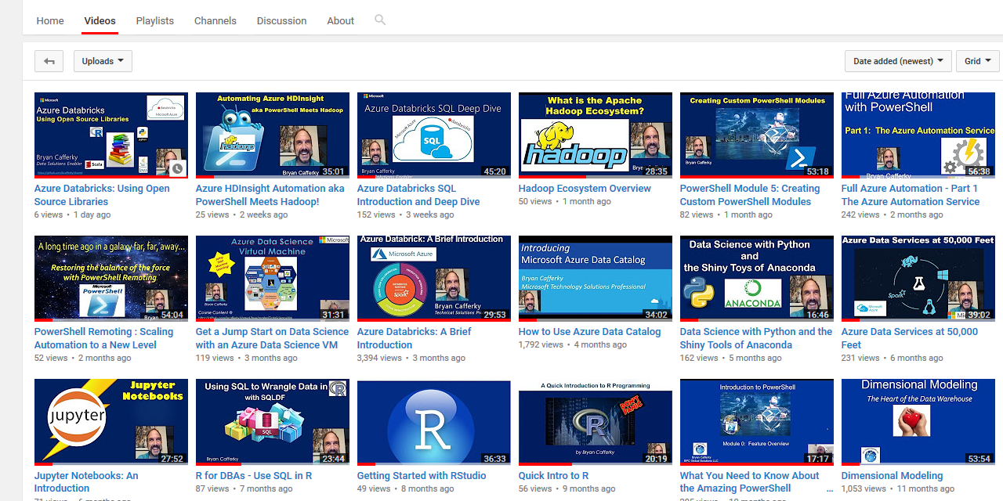
Subscribe to my YouTube Channel
https://www.youtube.com/c/BryanCafferky

Slide 4
What’s Ahead?
What is SSIS and ETL?
The Easiest Way to Use SSIS – The Import Wizard
Introduction to the SSIS Catalog
SQL Agent for Automation
Basic Demo of Developing an SSIS Project/Package.
Configuring SSIS Packages
Advice and Best Practices

Slide 5
What is SQL Server Integration Services?
First Class Service to extract, transform, and load, data in/out of SQL Server.
Is delivered as part of SQL Server since SQL Server 2005.
Visual Studio used to Develop/Deploy SSIS Packages.
Tightly integrated with SQL Server since SQL Server 2012.
Highly optimized for high throughput.
Now supported under the Azure Data Factory.

Slide 6
ETL Pattern: High Level
Stage data to table(s)
Minimal transformations
Avoid Errors here!
External
File
}
}
Extract
Maximize T-SQL
Filter as early as possible
Handle Errors
External File
Log Errors
Transform
Avoid duplicate keys
Remember Foreign Key Constraints
Configure destination for performance
Track audit statistics
Database
Load
Data
Warehouse

Slide 7
ETL Pattern
Start Job
Email Job Start
External
File
Truncate Staging table
Load file(s) into Staging table
}
Staging
Read Staging Table
Apply Transformations
Write to Staging or final Destination
Email Job Failure
Load final Staging table(s) to Destination
Data
Warehouse
Email Job End
Audit Counts
End Job

Slide 8
Making Your Life Easier
A SQL Statement walks up to two tables in a bar and asks, “May I join you?”

Slide 9
Making Your Life Easier
Use T-SQL as Much as Possible
Stage Input Data to SQL Server Tables at the Start
Avoid Hard Coding Values, use Parameters and Expressions
Use the Project Deployment Model and SSIS Catalog
Use Child Packages for Reusability
Never trust any user statements about the data because they do not consider exceptions or possible changes
Leverage SSIS parallel processing

Slide 10
ETL Pattern: Extract
Source format is the biggest issue
SQL Server: OLE DB usually best
Excel and MS Access are fragile
Convert Excel to CSV when possible
Proprietary sources like Salesforce may need 3rd Party Connection Managers
External flat files pose data corruption issues
What if the source data is not there?

Slide 11
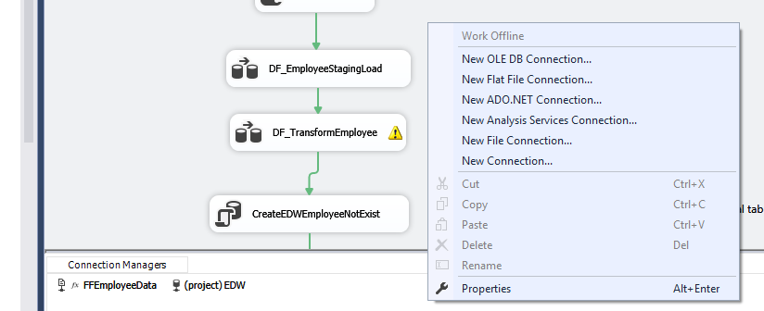
ETL Pattern: Extract – Connections
Create a Connection Manager

Slide 12
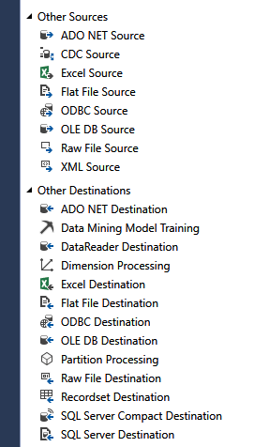
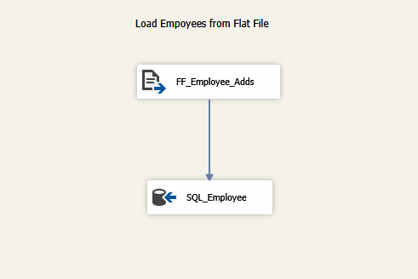
ETL Pattern: Extract – Connections
2. Create Add a Source or a Destination to a Data Flow
Source
Destination

Slide 13
Making Your Life Easier
What do you get when you cross SQL Server with Santa Clause?
A Where Clause

Slide 14
ETL Pattern: Transform
Data exception errors likely so trap for them
SSIS Derive Column and Transform Available
Cryptic, Awkward, and Fragile.
Avoid blocking transformations like aggregations
Script components can save your life
Sometimes its better to layer the transformations

Slide 15
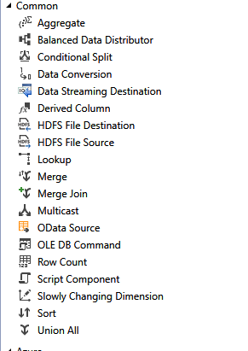
ETL Pattern: Transformations
Most of these can be done with T-SQL as well.

Slide 16
ETL Pattern: Load
SQL Server will usually be the destination.
Log your metrics: Added, Changed, Deleted
Reroute error rows and report them.

Slide 17
ETL Best Practices
Use Dynamic Configuration (parameters) to avoid editing code.
Trap, Log, and Report Errors.
Fail a job rather than let an error silently get through.
Use annotations and comments.
Assume anything can and will go wrong. Assumptions are futile.
Plan out deployments carefully and script our where possible.
All ETL jobs should be COMPLETELY automated!!!
Export Excel files to CSV or similar format before loading.

Slide 18
SSIS

Slide 19
ETL Questions
Did my ETL job run? When?
Did the job succeed or fail? Where? Why?
If the job fails, how do we recover?
How many rows were added, changed, deleted?
How long did the job take to run?
Is the data correct? Quiet errors can corrupt data.
How much input data will there be? How Often?
Is there adequate space in the destination?

Slide 20
Making Your Life Easier
What is James Kirk’s Middle Name in the Star Trek Original Series?

Slide 21
SSIS Jump Start
Architectural Details
New Architecture Addresses Many SSIS Limitations!
New SSIS Catalog in SQL Server managed via SSMS.
Built-in SSRS Reports on package executions.
Project Deployment Model: All the packages in the project are deployed together.
Configurable Project and Package parameters.
Environments – containers of configurations settings.
True database service execution.

Slide 22
SSIS Jump Start
Project Deployment Model
All the packages in the project are deployed together.
Packages in the project can share Parameters and Connection Managers.
Parameter and Configuration Values can easily be configured in SSMS.
The Legacy Package Deployment Model is available but does not support the above features.

Slide 23
SSIS Jump Start
The SSIS Catalog
Demo

Slide 24
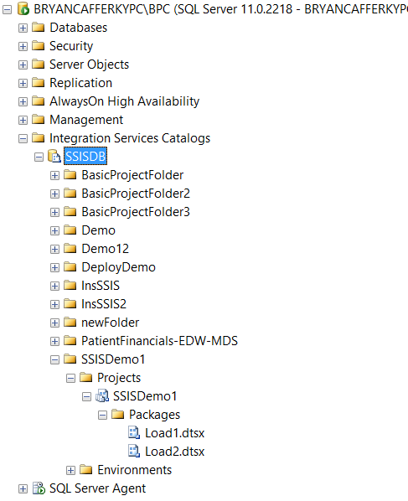
SSIS Jump Start: SSIS Catalog
Drum roll……The SSIS Catalog!

Slide 25
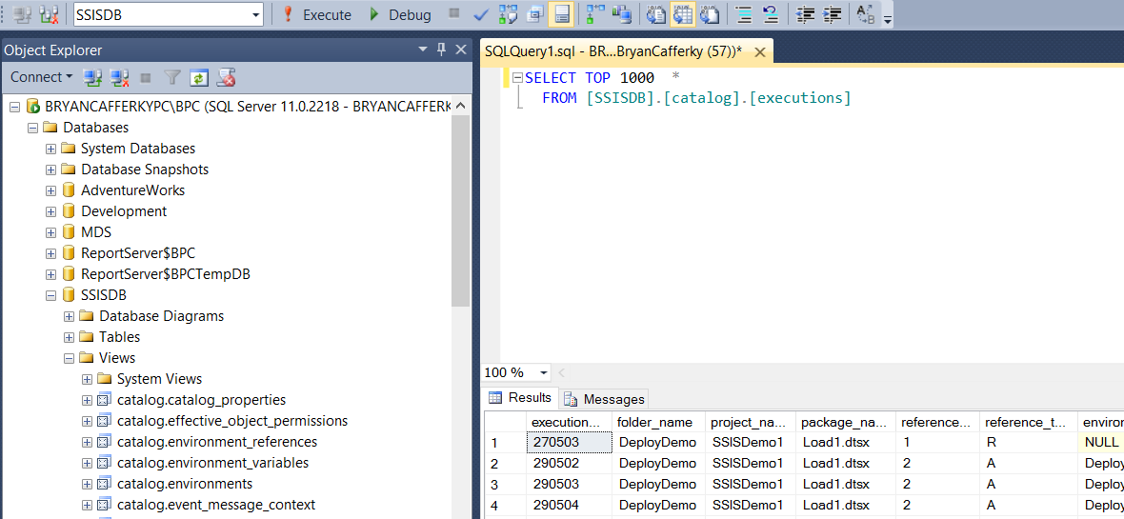
SSIS Jump Start
SSIS catalog views – The dba’s dream come true

Slide 26
SSIS Jump Start
SSIS Projects and Deployment
Demo

Slide 27
SSIS Jump Start: SQL Server Data Tools Review

Slide 28
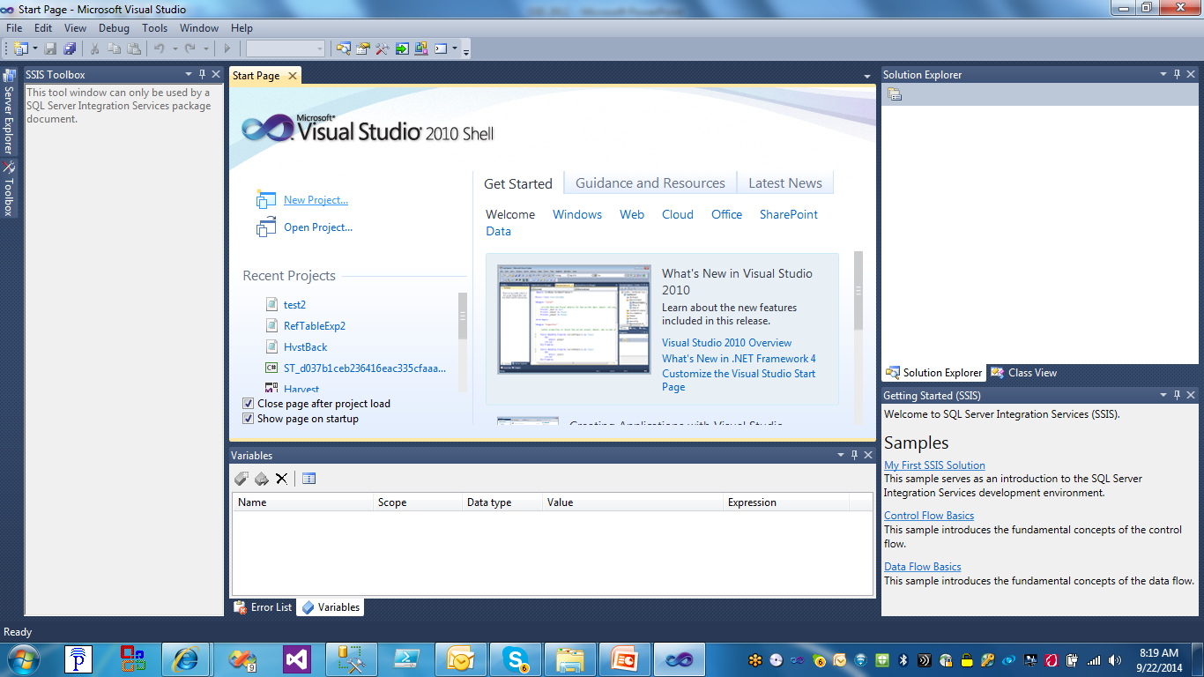
SSIS Jump Start
Creating a Project
Click on New Project

Slide 29
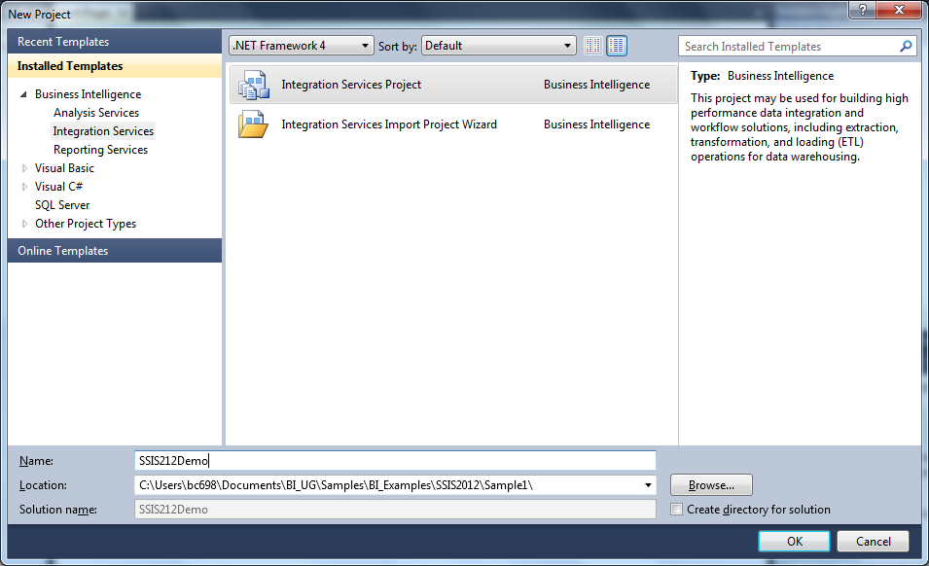
SSIS Jump Start
Creating a Project
Click on Integration Services Project

Slide 30
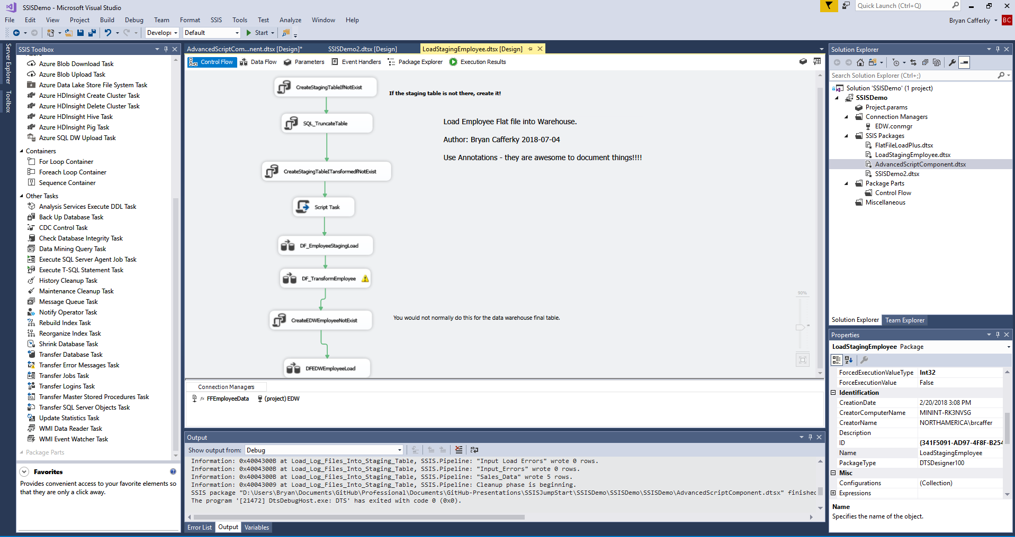
SSIS Jump Start: The Package
Toolbox
Variables
Control Flow
Object Properties
Data Flow
Solution Explorer
Data Connections

Slide 31
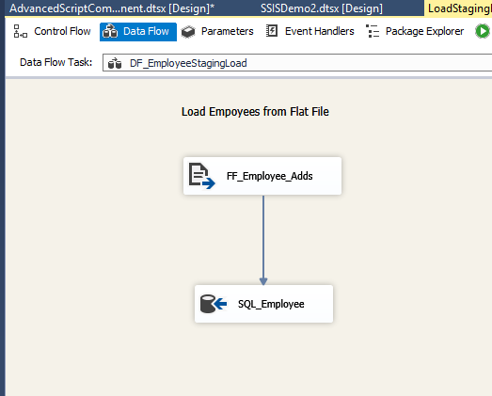
SSIS Jump Start: Data Flow
Data Flow pumps data from sources to Destinations

Slide 32
Making Your Life Easier
Where did the name ‘The Imitation Game’ come from in the movie about Alan Turing?

Slide 33
SSIS Jump Start: Deployment Review

Slide 34
SSIS Jump Start
Deploying a project overview
Loads the entire project, i.e. all packages with current settings to the SSISDB in the Integration Services Catalogs.
Can be exported from the catalog as needed and restored to a Data Tools project.
Packages can be configured in the catalog and executed from the catalog.
SSISDB is a central repository for SSIS packages on a given SQL Server instance.

Slide 35
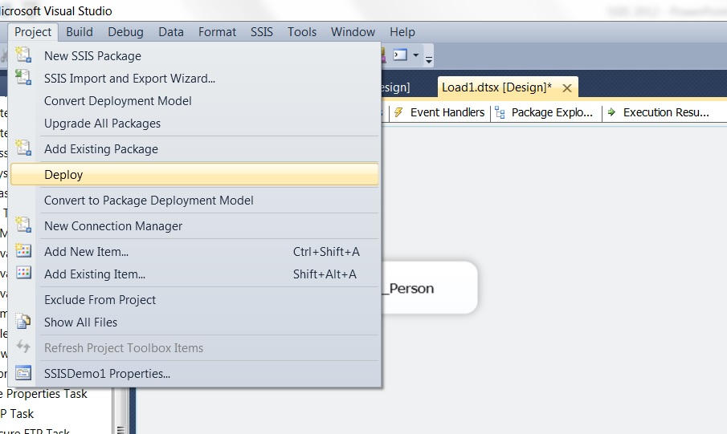
SSIS Jump Start
Deploying a project – Step 1
Click on Project and then Deploy.

Slide 36
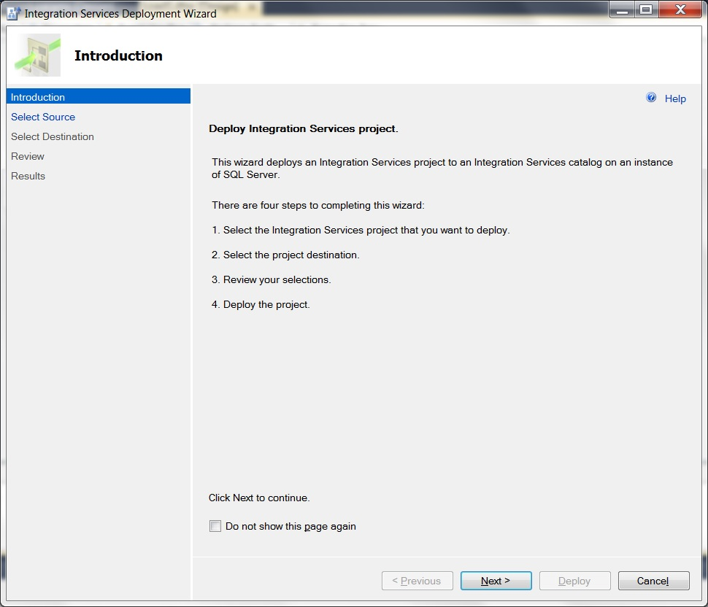
SSIS Jump Start
Deploying a project – step 2
The Deployment Steps screen. Click Next.

Slide 37
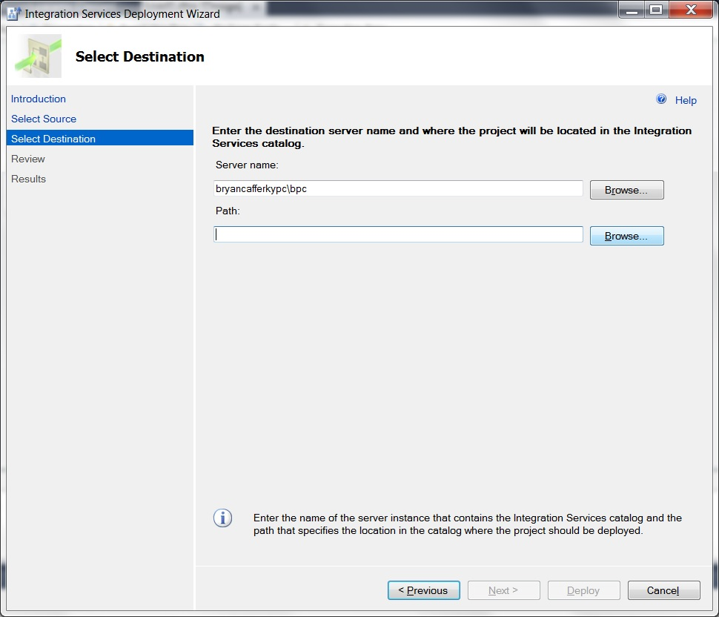
SSIS Jump Start
Deploying a project – step 3
Enter the SQL Server Instance where the project should be deployed. Click Browse to locate the folder.

Slide 38
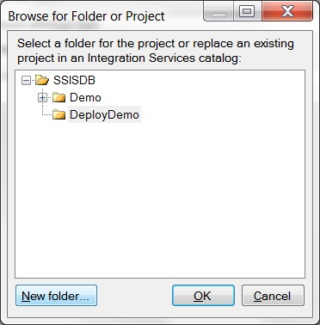
SSIS Jump Start
Deploying a project – step 4
Select the folder or click on New Folder to create a one.

Slide 39
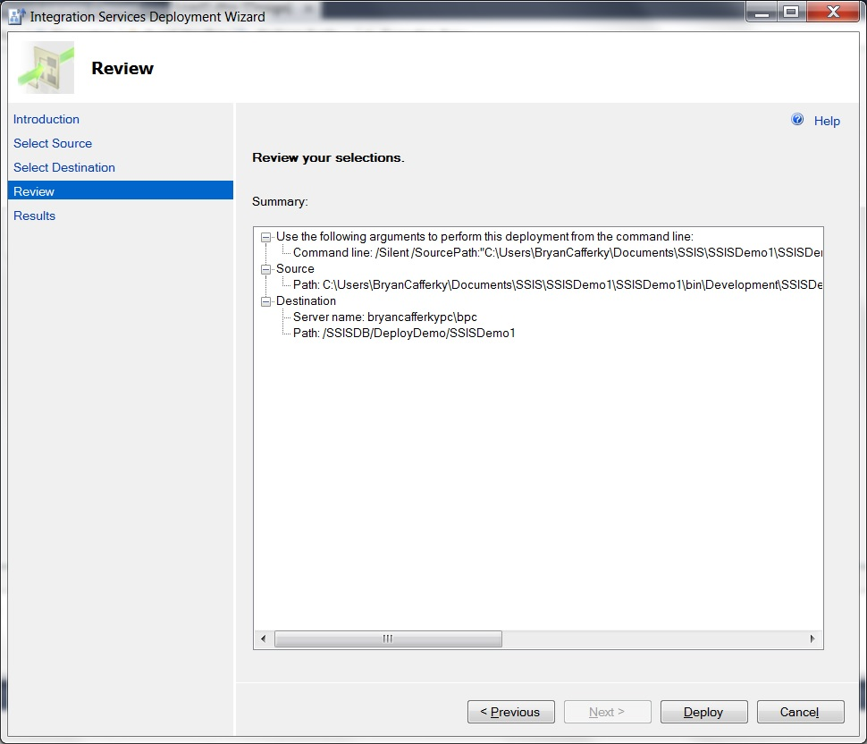
SSIS Jump Start
Deploying a project – step 5
Verify the settings and click Deploy.

Slide 40
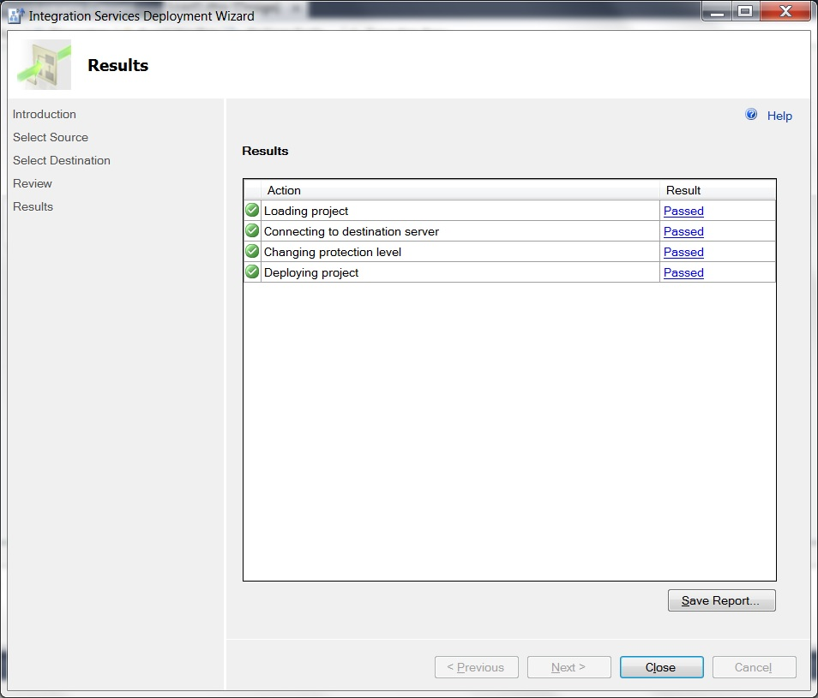
SSIS Jump Start
Deploying a project – step 6
The deployment confirmation screen shows all tasks Passed. Click Close when ready.

Slide 41
SSIS Jump Start: Configuration

Slide 42
Making Your Life Easier
Who was the co-founder of Apple?

Slide 43
SSIS Jump Start: Why Configuration?
Things like Server Names and Folder names will change.
How can we avoid modifying our packages for each change?
Answer: We can bind these changing attributes to parameters.
Parameters can be changed from Outside the Project/Package.
They can be passed to the package at run time.

Slide 44

SSIS Jump Start
New in 2012 – Configuration
QA
Development
QA
Production
SSIS Catalog
Project Folder
SSISProject1
SSISEnv1
Server=devserver
SSIS Catalog
SSISDemo Folder
SSISProject1
SSISEnv1
Server=qaserver
SSIS Catalog
SSISDemo Folder
SSISProject1
SSISEnv1
Server=prodserver
You can deploy the project to each server and it automatically picks up the
configuration settings for that server. Note: We are using relative references.

Slide 45
SSIS Jump Start
Demo

Slide 46
Making Your Life Easier
What does the entry in The Hitchhiker's Guide to the Galaxy say about Earth?

Slide 47
SSIS Jump Start: Configuration Review

Slide 48
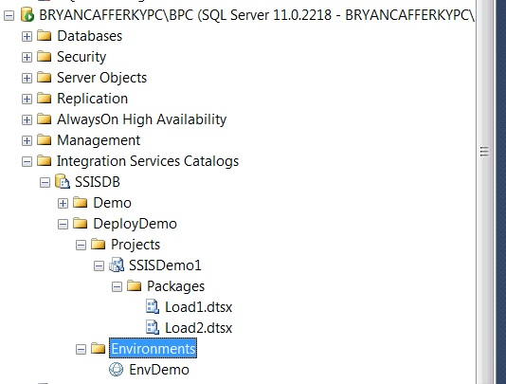
SSIS Jump Start
New in 2012 – The Integration Services Catalog - Environments
SSIS Environment.
An Environment is just a set of Project Configuration Values stored
as an object in the catalog. The idea is that for each environment, Dev,
Integration, QA and Production, the configuration values will need to be
Different. SSIS Environments make this easier to manage.

Slide 49
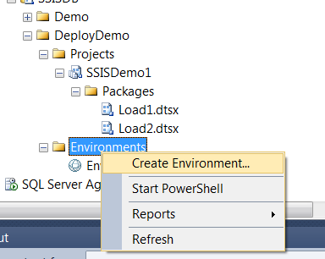
SSIS Jump Start
New in 2012 – The Integration Services Catalog - Environments

Slide 50
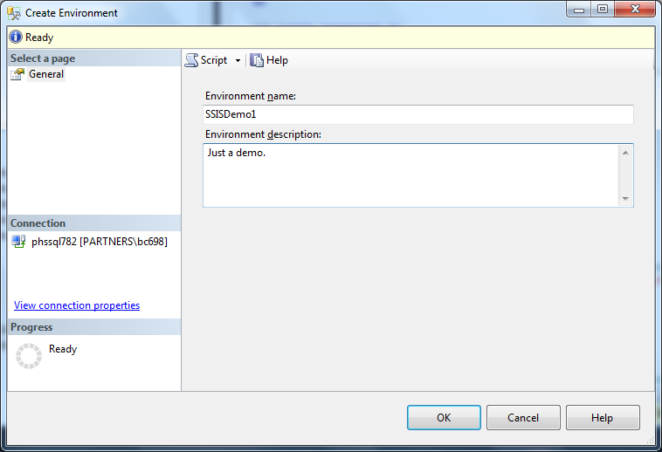
SSIS Jump Start
New in 2012 – The Integration Services Catalog - Environments
Enter a named and description and click Ok.

Slide 51
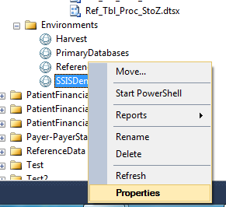
SSIS Jump Start
New in 2012 – The Integration Services Catalog - Environments
Right Mouse Click and select Properties to edit.

Slide 52
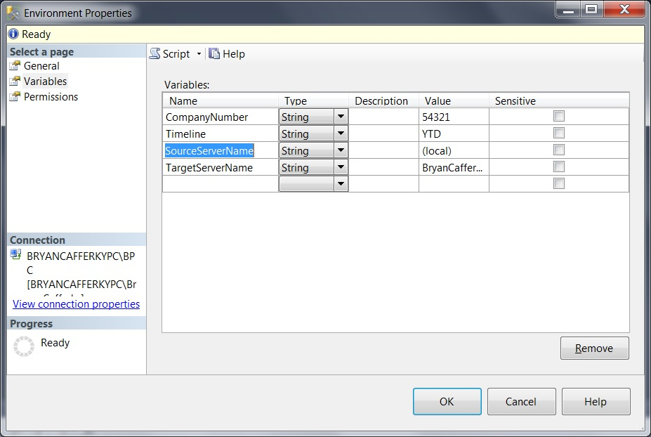
SSIS Jump Start
New in 2012 – The Integration Services Catalog - Environments
Enter variable names and values. These will be assigned to configuration properties.

Slide 53
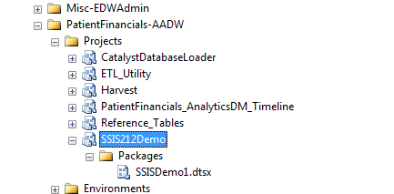
SSIS Jump Start
You can see the project in the catalog.

Slide 54
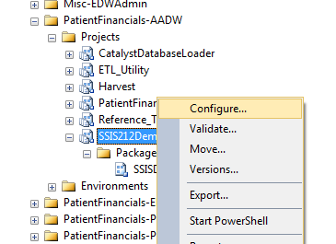
SSIS Jump Start
New in 2012 – Configuration
Right mouse click on the Project and select Configure.

Slide 55
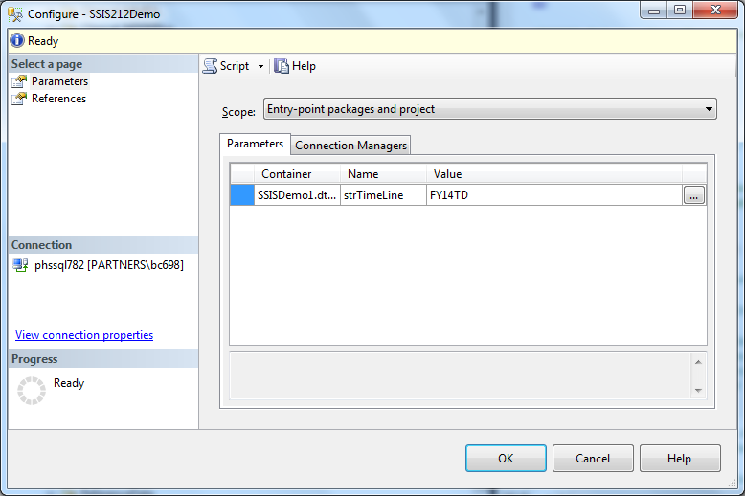
SSIS Jump Start
Click on the refrences to configure.

Slide 56
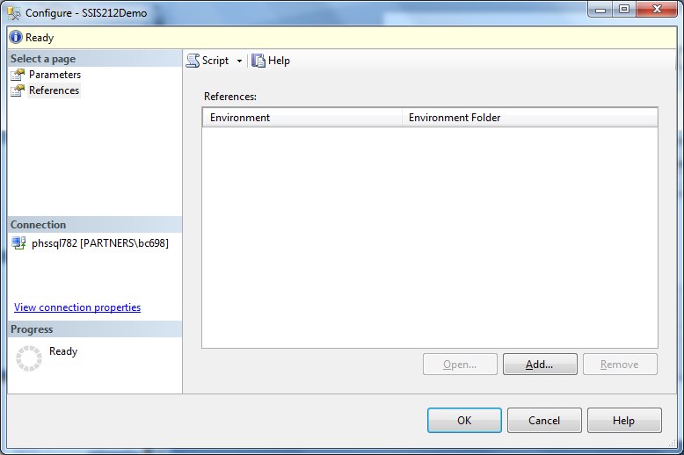
SSIS Jump Start
Click on Add to add a reference to an Environment.

Slide 57
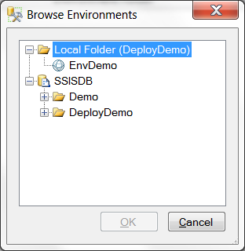
SSIS Jump Start
Click on the environment and Ok.

Slide 58
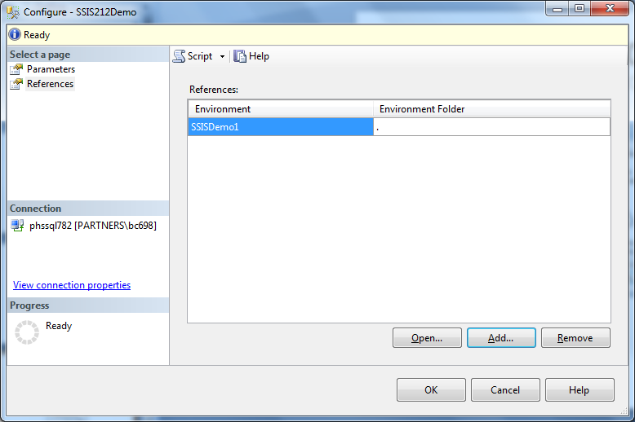
SSIS Jump Start
You can see the reference was added..

Slide 59
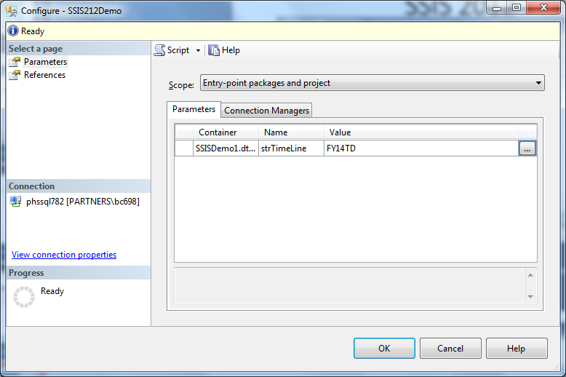
SSIS Jump Start
Click on Parameters and then the ellipsis.

Slide 60
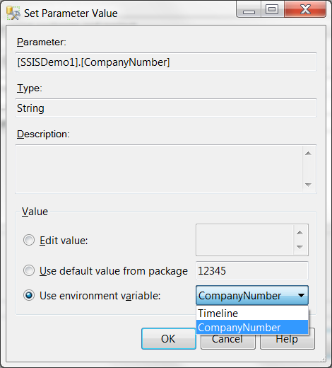
SSIS Jump Start
Check Use Environment variable and select a variable.

Slide 61
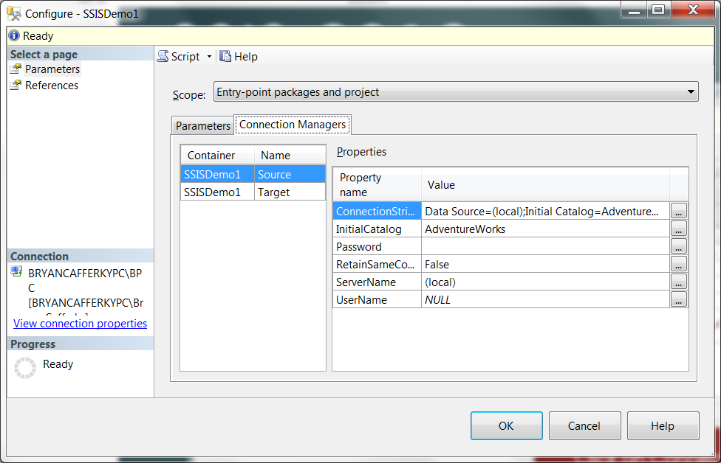
SSIS Jump Start
Click on Connection Managers and the ellipsis next to ServerName.

Slide 62
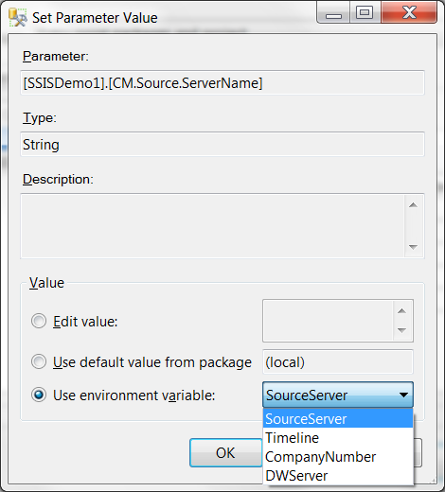
SSIS Jump Start
Check ‘Use environment variable’ and select the variable from the drop down..

Slide 63
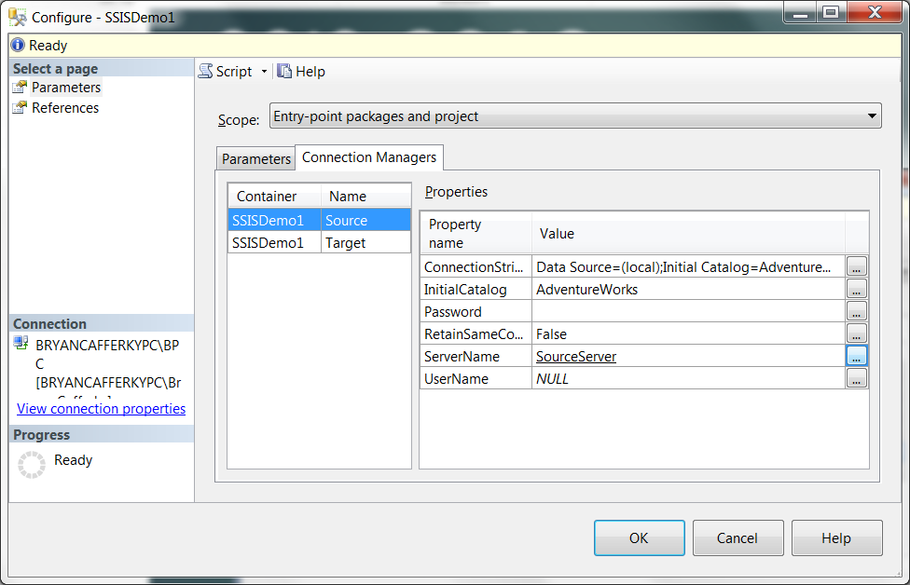
SSIS Jump Start
New in 2012 – Configuration
Notice ServerName is now set to the environment variable name.

Slide 64
SSIS Jump Start: Wrapping Up
What is SSIS and ETL?
Introduction to the SSIS Catalog
SQL Agent for Automation
Basic Demo of Developing an SSIS Project/Package.
Configuring SSIS Packages
Advice and Best Practices

Slide 65
SSIS Jump Start
Q & A

Slide 66
SSIS Jump Start: Package Configuration

Slide 67
SSIS Jump Start

Slide 68
SSIS Jump Start
Slides on Parameterizing Packages

Slide 69
SSIS Jump Start
Parameters:
Variables that can be configured externally.
Can be scoped to the package or project.
Variables can get their value from a parameter.

Slide 70
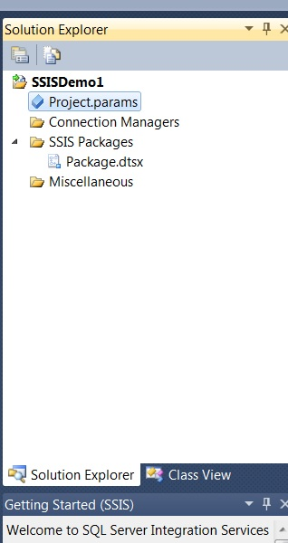
SSIS Jump Start
Creating a Project – Project Parameter
Double Click on the Project.parameters to create Project Parameters.
Project Parameters are just Project Level scoped variables but they are exposed
To the Configuration Editor in SSMS and SQL Agent.

Slide 71
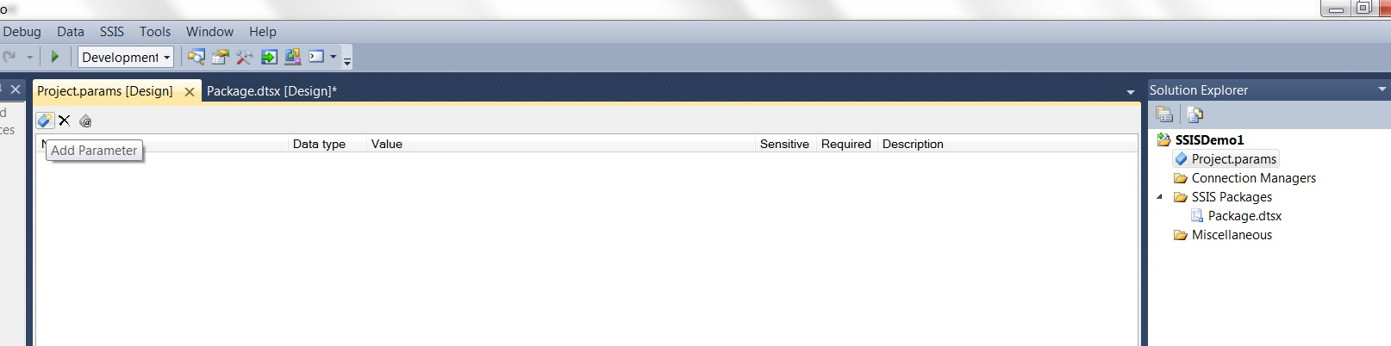
SSIS Jump Start
Creating a Project – Project Parameter
Click on the Add Parameter Icon

Slide 72
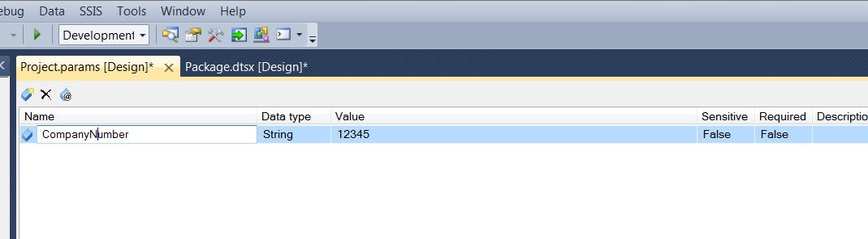
SSIS Jump Start
Creating a Project – Project Parameter
Enter Parameter Details

Slide 73
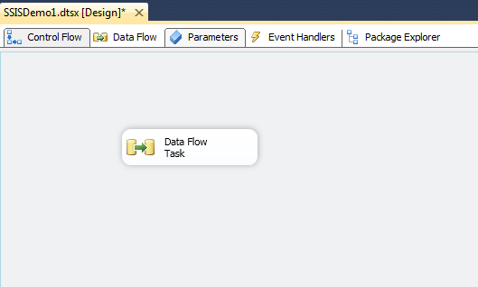
SSIS Jump Start
Creating a Project – package Parameter
With a package open, click on the Parameters tab so we can create Project Parameters.

Slide 74
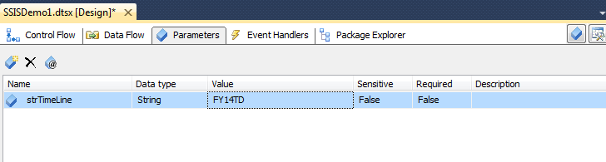
SSIS Jump Start
Creating a Project – PACKAGE Parameter
Create a new Parameter. You can make it required.

Slide 75
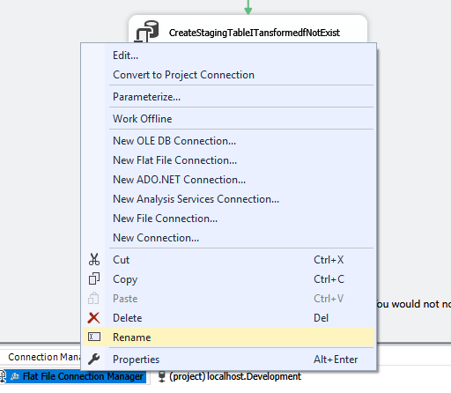
SSIS Jump Start
Creating a Project – PACKAGE Parameter
Right Mouse Click and Select Rename to Give Objects Meaningful Names

Slide 76
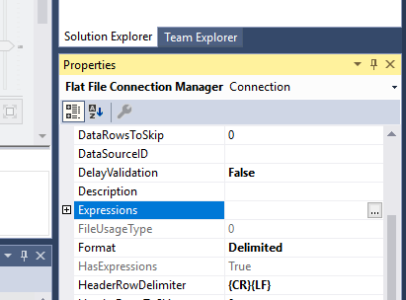
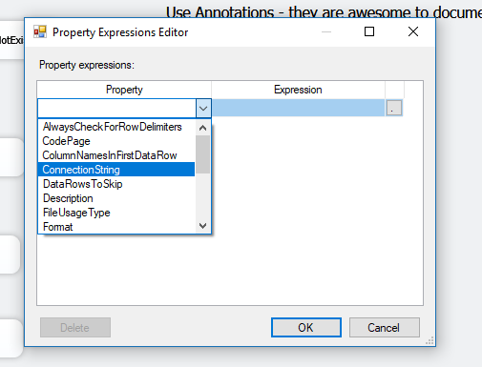
SSIS Package Configuration
Choose the Property
Create/Edit Expressions

Slide 77
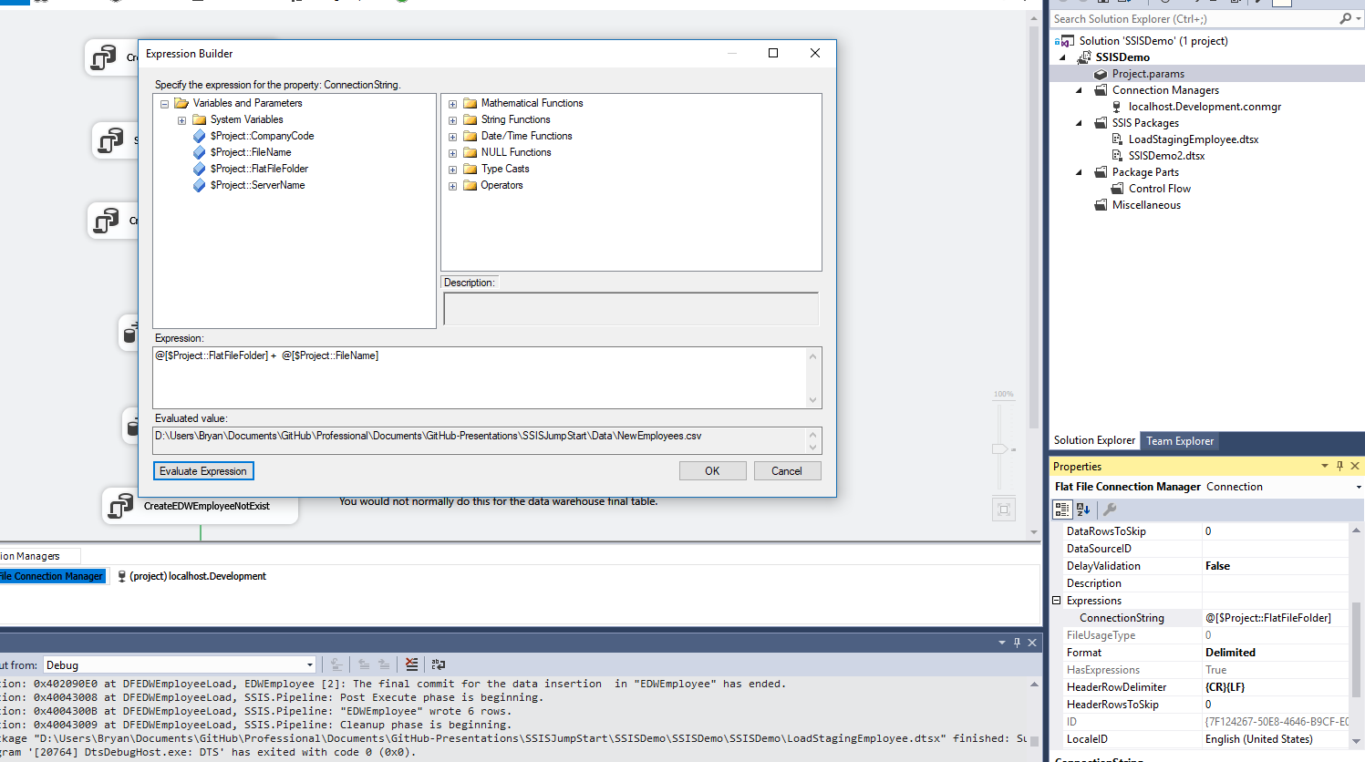
SSIS Package Configuration
Build the Expression
Setting the Connection String
Click on Expressions
Evaluate to Check the Value

Slide 78
SSIS Package Configuration
An Alternative Approach is to use the Parameterize Dialog but this is more restrictive.

Slide 79
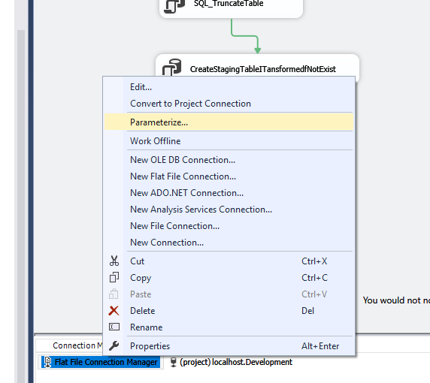
SSIS Package Configuration
Click on Parameterize
Right Mouse Click

Slide 80
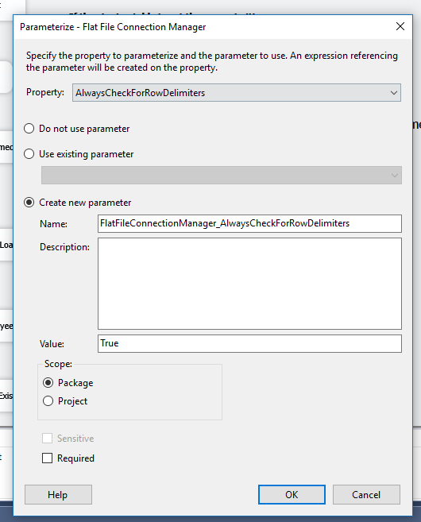
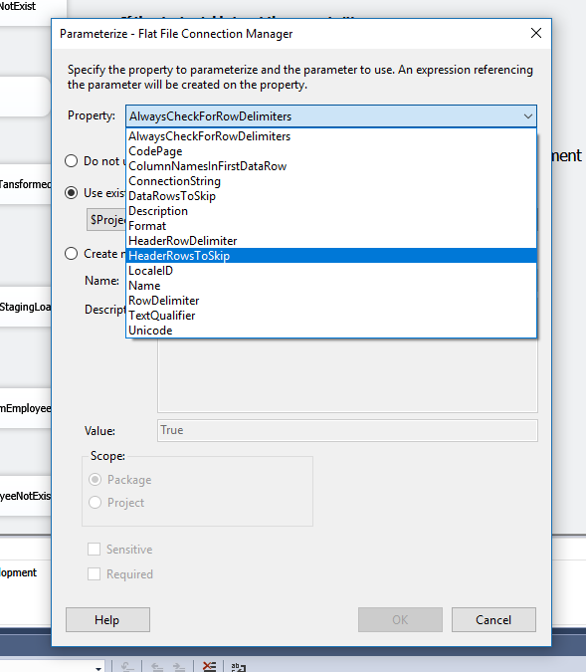
SSIS Package: Parameterize Dialog
Select the Property
This approach does not let you use expressions!!!
Bind Parameters to Properties

Slide 81
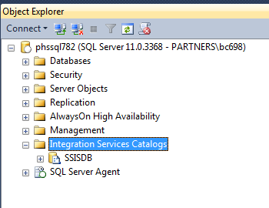
SSIS Jump Start
New in 2012 – The Integration Services Catalog Catalog
Exposes Projects, Packages and Configurationns.

Slide 82
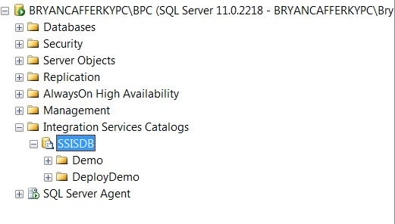
SSIS Jump Start
New in 2012 – The Integration Services Catalog
Folders hold Projects and Environments.

Slide 83
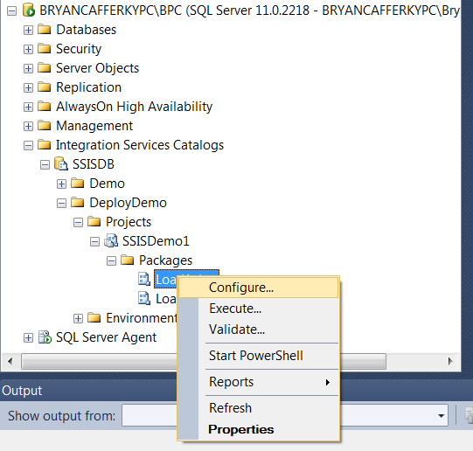
New in 2012 – The Integration Services Catalog
Right Mouse Click on a Package or Project to get a Context Sensitive Menu. Select Configure.

Slide 84
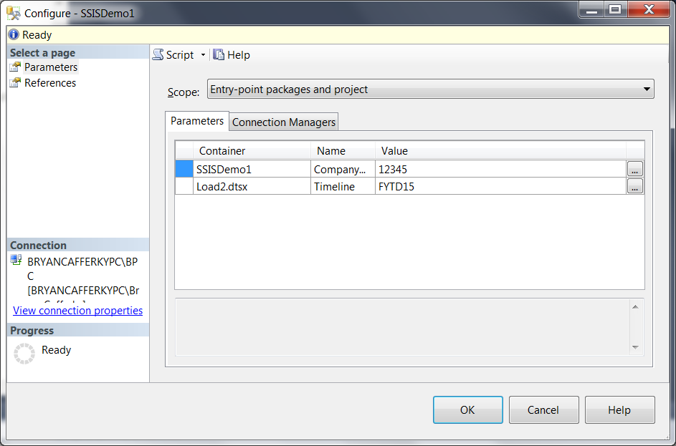
SSIS Jump Start
New in 2012 – The Integration Services Catalog - Configuration
Enter values for Project Parameters and Connection Managers.

Slide 85
SSIS Jump Start
Using SSIS with SQL Agent

Slide 86
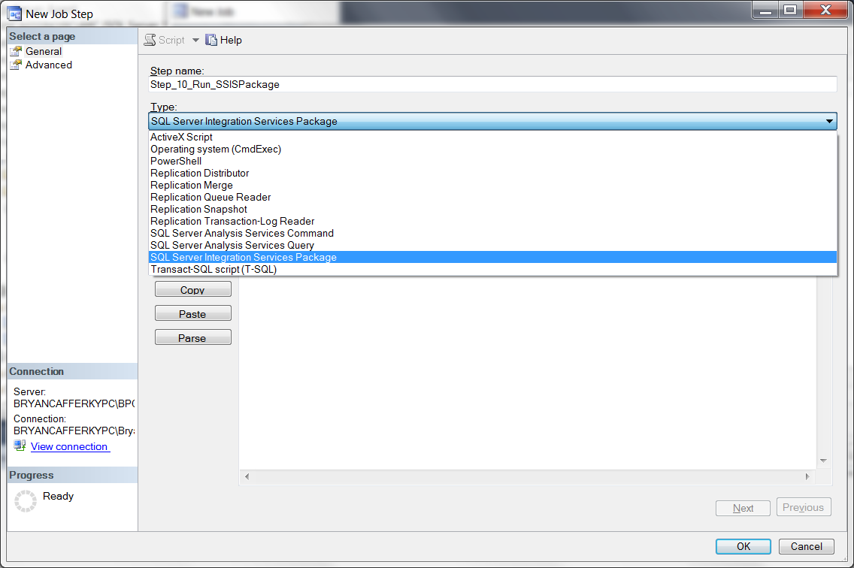
SSIS Jump Start
Using SSIS with SQL Agent

Slide 87

SSIS Jump Start
Using SSIS with SQL Agent
After entering the server name, click the ellipsis next to the Package text box.

Slide 88

SSIS Jump Start
Using SSIS with SQL Agent

Slide 89

SSIS Jump Start
Using SSIS with SQL Agent

Slide 90

SSIS Jump Start
Using SSIS with SQL Agent

Slide 91

SSIS Jump Start
Using SSIS with SQL Agent

Slide 92

SSIS Jump Start
Using SSIS with SQL Agent

Slide 93
SSIS Jump Start
Using SSIS with SQL Agent
Can use package/project defaults.
Can use Environment variables.
Can be overridden with hard coded values.

Slide 94

SSIS Jump Start
Using SSIS with SQL Agent

Slide 95

SSIS Jump Start
Using SSIS with SQL Agent

Slide 96


Slide 97
SSIS Jump Start
Built-in SSRS Reports

Slide 98

SSIS Jump Start
New in 2012 – SSRS Reports
When a package fails, you need to view Reports from the catalog to get details.

Slide 99

SSIS Jump Start
New in 2012 – SSRS reports
Click on All Messages for error details.

Slide 100
SSIS Jump Start: Additional Slides

Slide 101

SSIS Jump Start
New in 2012 – Project Parameters
And
Project Level Connection Managers

Slide 102

SSIS Jump Start
Creating a Project – Creating a Connection Manager
Right Mouse Click and Select New Connection Manager to create a Project Level Connection Manager

Slide 103

SSIS Jump Start
Creating a Project – Creating a Connection Manager
Select the Connection Type. OLEDB is the most common, i.e. SQL Server.

Slide 104

SSIS Jump Start
Creating a Project – Project Connection Manager
Enter the Connection Properties.

Slide 105

SSIS Jump Start
Creating a Project – Project Connection Manager
Note: (project) indicates this is a Project Level Connection Manager.

Slide 106

SSIS Jump Start
Add a Data Flow.

Slide 107
SSIS Jump Start
Appendix

Slide 108

Fixing When Data Changes

Slide 109

Fixing When Data Changes

Slide 110

Testing a Single Task

Slide 111
Disabling a Task During Testing

Slide 112

Disabling a Task During Testing

Slide 113

Creating a Derived Column

Slide 114

Creating as Derived Column

Slide 115

SSIS Data Flow Function Expressions
SSIS Functions are NOT Intuitive
Need to cast StartDate so it can be used in calculation
https://docs.microsoft.com/en-us/sql/integration-services/expressions/datediff-ssis-expression?view=sql-server-2017

Slide 116

SSIS Jump Start
Creating a Script Task
Script Task adds a C# or VB.Net script to the control flow

Slide 117


SSIS Jump Start: Advanced – Script Task
Edit/Create Script
Select language. One time only!

Slide 118

SSIS Jump Start: The Script Editor
Enter your code here.
https://www.mssqltips.com/sqlservertip/3410/get-progress-information-for-ssis-script-tasks/

